Slide 1
Business Loans
Eve Bailey

Slide 2
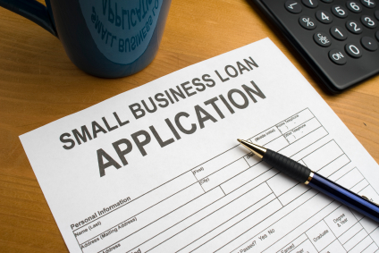
SBA loans
Also knows as small business loans
They are lower cost and longer term
Easier to qualify for than bank loans
But harder to qualify for than other lending products
Long application and time to funding
Average interest rate is 3.26%

Slide 3
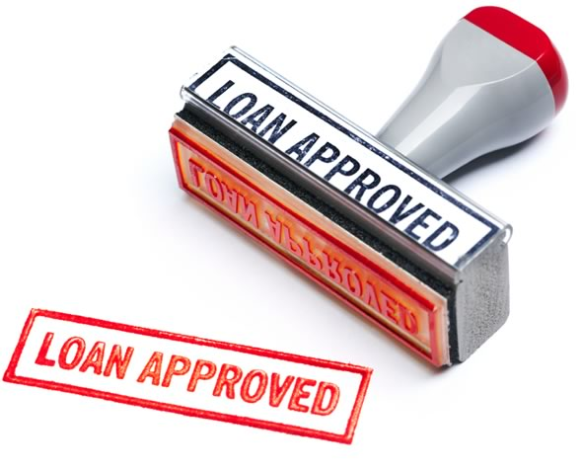
Online Term Loans
Faster approval rates than banks
Easier to qualify for
Lower interest rates and longer term
Higher costs than SBA or bank loans
Higher qualification standards
Average interest rate is 4.8%

Slide 4
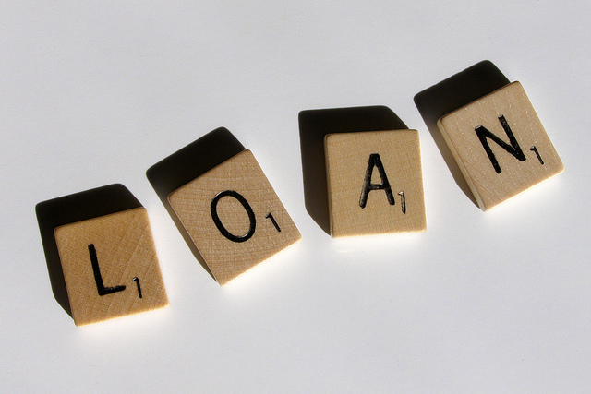
Short term loans
Fast time to funding
Suitable for a wide range of banking purposes
Easy to qualify for
Higher APR’s of longer-term loans
Often requires daily payment
Average interest rate is 11%

Slide 5
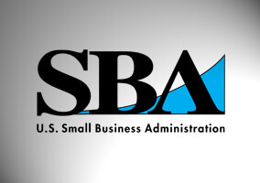
What business loan I picked and why
I chose the SBA, or small business loan. The reason I chose this is because I am starting up a small business, so the SBA loan is the most useful. It has a lower interest rate and a longer term to pay the money back.

Slide 6
How the loan affects my monthly profit
My business is a salon and my employees don’t get paid a set salary every month. So, it all depends how many clients my employees bring in whether or not my business is still sustainable.

